Slide 1
Name
Address
Historic Nomination
Name Commission Presentation
Note – please update highlighted text throughout template as necessary

Slide 2
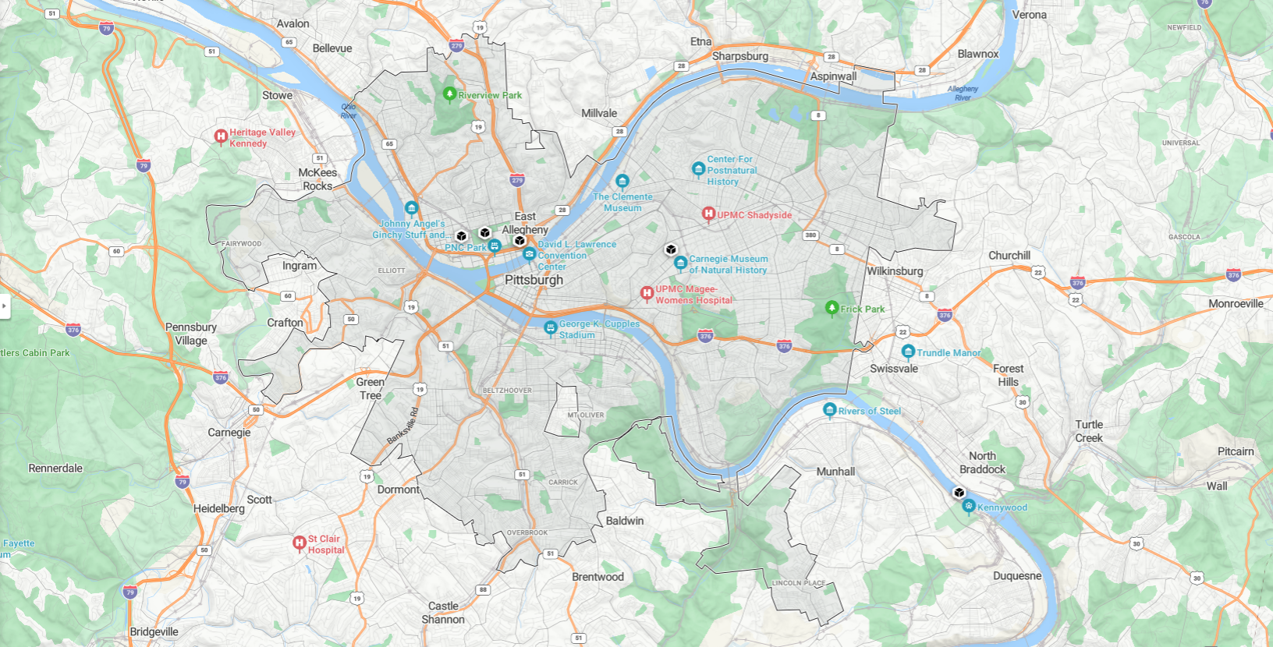
Location Map
Image courtesy Bing Maps

Slide 3
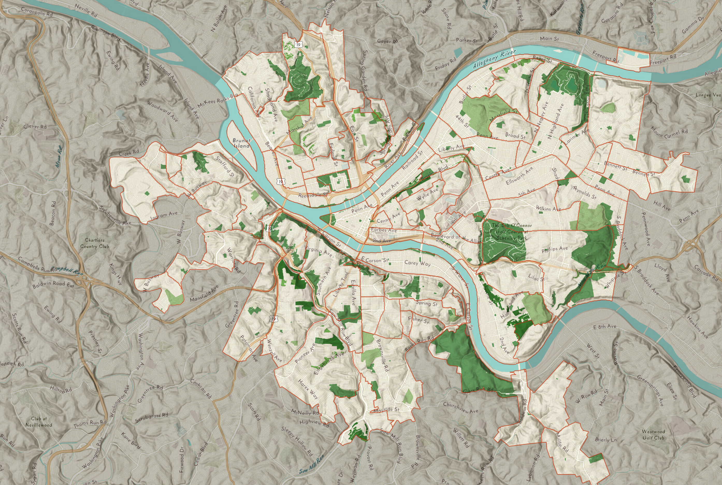
Neighborhood Map
Image courtesy City of Pittsburgh GIS

Slide 4
Site Plan
Image courtesy Google Maps

Slide 5
Photos – duplicate slide as necessary to support nomination. Label all photos
Image courtesy name

Slide 6
Where we are in the process
Historic Review Commission
Recommendation to City Council
Historic Review Commission
Determination of Viability
date
City Council
Public Hearing
City Council
Vote
Planning
Commission
Recommendation to City Council
date
date
date
date

Slide 7
Criteria for historic designation
Include slide for Historic Review Commission and City Council presentations

Slide 8
Integrity worthy of preservation or restoration
Include slide for Historic Review Commission and City Council presentations

Slide 9
Include slide for Planning Commission presentation
Per Title 11 – 1101.03(g) – The City Planning Commission shall consider effects of designation on adjoining properties and surrounding neighborhoods within the framework of established planning, development and land use objectives for the City of Pittsburgh

Slide 10
Letters of support (if applicable)
name
name
name

Slide 11
Thank you.

